Slide 1
Distance Based Suspicion Score for Audit Data Selection
presented by Nuriddin Tojiboyev

Slide 2
Audit Analytics Problem
Company Processes
Overwhelming number of Exceptions
Company Data
Automated Audit Filters
???
Financial Statements
Assertions
Audit Evidence

Slide 3
Transaction-level Audit Risk Feature Engineering
Understanding the Audit Risk Factors
FEATURE ENGINEERING
Transaction Feature - A
Transaction Feature - B
Transaction Feature - C
Audit Risk Feature X (A, B, C)

Slide 4
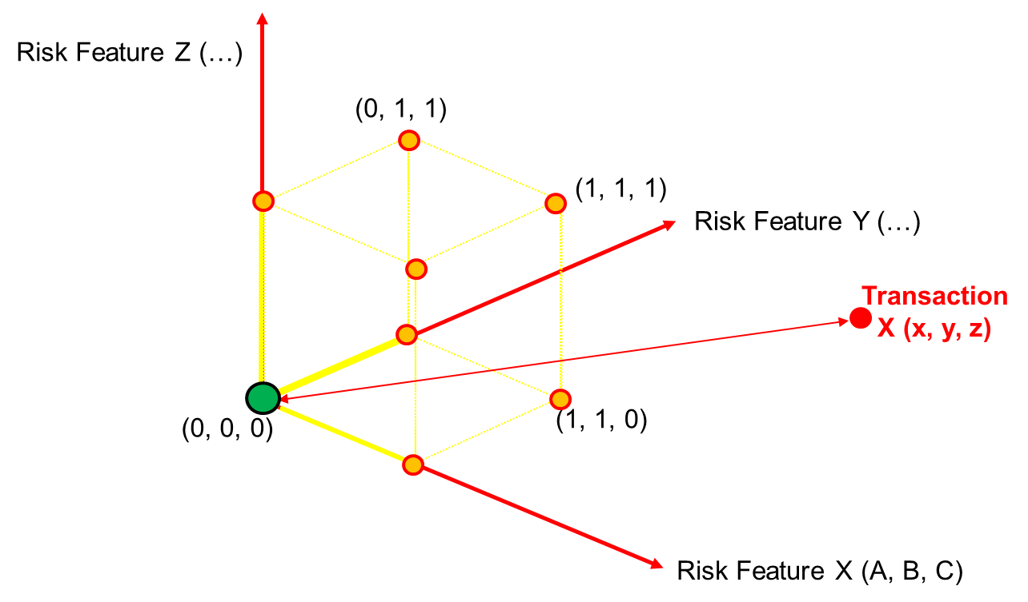
“Risk Space”
Notes:
Characteristics of “Risk Space”
“Risk Space” is made of “risk dimensions”
Each “risk dimension” represents a metric for how each transaction puts each relevant assertion at risk.
Comparability among “risk dimensions” allows to aggregate the riskiness of transactions on all “risk dimensions”
Investigator should be indifferent to investigate on of the transactions have same level of risk on two different “risk dimensions”
The main question is how to engineer “risk measures” for risk dimensions
One way is a “Thresholds Approach”

Slide 5
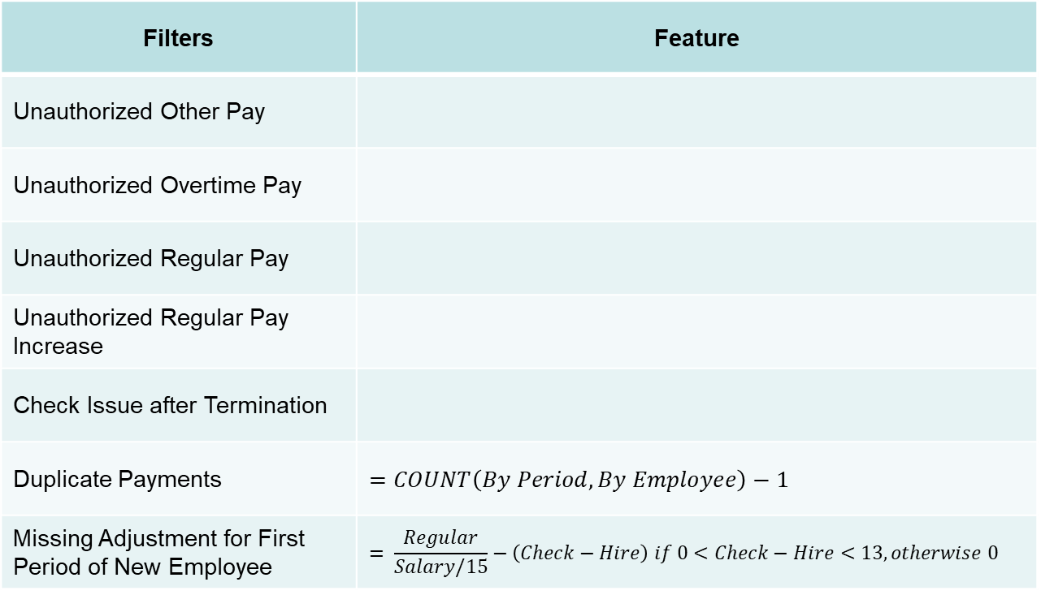
Engineered Risk Features
Filters | Feature
Unauthorized Other Pay
Unauthorized Overtime Pay
Unauthorized Regular Pay
Unauthorized Regular Pay Increase
Check Issue after Termination
Duplicate Payments | $$=COUNT\left(By Period, By Employee\right)−1$$
Missing Adjustment for First Period of New Employee | $$= \frac{Regular}{Salary/15}−\left(Check−Hire\right) if 0<Check−Hire<13,otherwise 0$$
$$=\frac{Other Pay}{2000 if Regular=0, otherwise 10\%∗Regular, }$$
$$=\frac{Overtime}{25\%∗Regular}$$
=$\frac{Regular−Salary}{10\%∗Salary}$ if Regular>Salary , otherwise 0
$= \frac{Regular−Mode(Emp.Reg.)}{20\%∗Mode(Emp.Reg.)}$ 𝑖𝑓 𝑅𝑒𝑔𝑢𝑙𝑎𝑟>𝑀𝑜𝑑𝑒(𝐸𝑚𝑝.𝑅𝑒𝑔.), otherwise 0
$$=\frac{Check Amount}{1000} ifCheck >Termination +15, otherwise 0$$

Slide 6
Descriptive Statistics Risk Feature Values
Risk | MIN | MAX | MEAN | MEDIAN | SD | Exceptions (≥1)
Unauthorized Other Pay | 0.00 | 87.69 | 0.11 | 0.00 | 1.41 | 222
Unauthorized Overtime Pay | 0.00 | 36.26 | 0.03 | 0.00 | 0.39 | 94
Unauthorized Regular Pay | 0.00 | 3.56 | 0.00 | 0.00 | 0.09 | 27
Unauthorized Regular Pay Increase | 0.00 | 12.77 | 0.09 | 0.00 | 0.54 | 278
Check Issue after Termination | 0.00 | 174.38 | 0.06 | 0.00 | 1.82 | 83
Duplicate Payments | 0.00 | 3.00 | 0.08 | 0.00 | 0.29 | 1046
Missing Adjustment for New Employee | 0.00 | 4.00 | 0.01 | 0.00 | 0.14 | 21

Slide 7
Distance Based Suspicion Score

Slide 8
Thank you!!! Questions?!

